Slide 1



Lecture – 1 Introduction to Systems Analysis and Design
CSE347 – Information System Analysis and Design
Instructor: Md. Sabbir Hossain,
Lecturer, CSE, EWU

Slide 2
System Development Life Cycle (SDLC)
The System Development Life Cycle (SDLC) provides a well-structured framework that gives an idea, of how to build a system.
It encompasses a series of interconnected stages that ensure a systematic approach to system development.
It is a conceptual model which includes policies and procedures for developing or altering systems throughout their life cycles.
SDLC is used by analysts to develop an information system.
SDLC includes the following activities −
requirements
design
implementation
testing
deployment
operations
maintenance

Slide 3
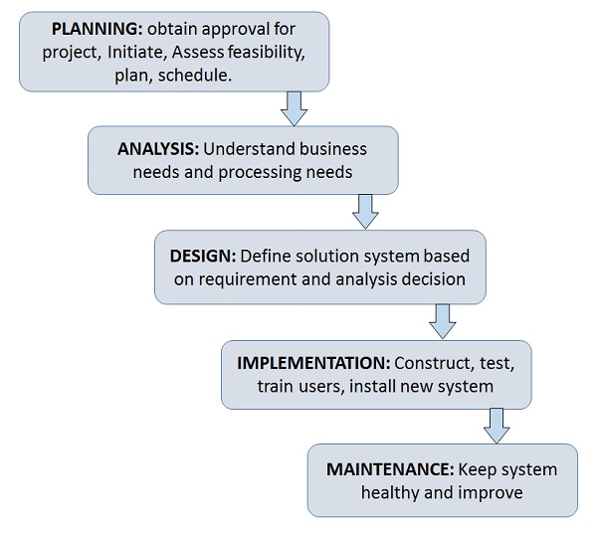
Phases of SDLC
Systems Development Life Cycle is a systematic approach which explicitly breaks down the work into phases that are required to implement either new or modified Information System.

Slide 4
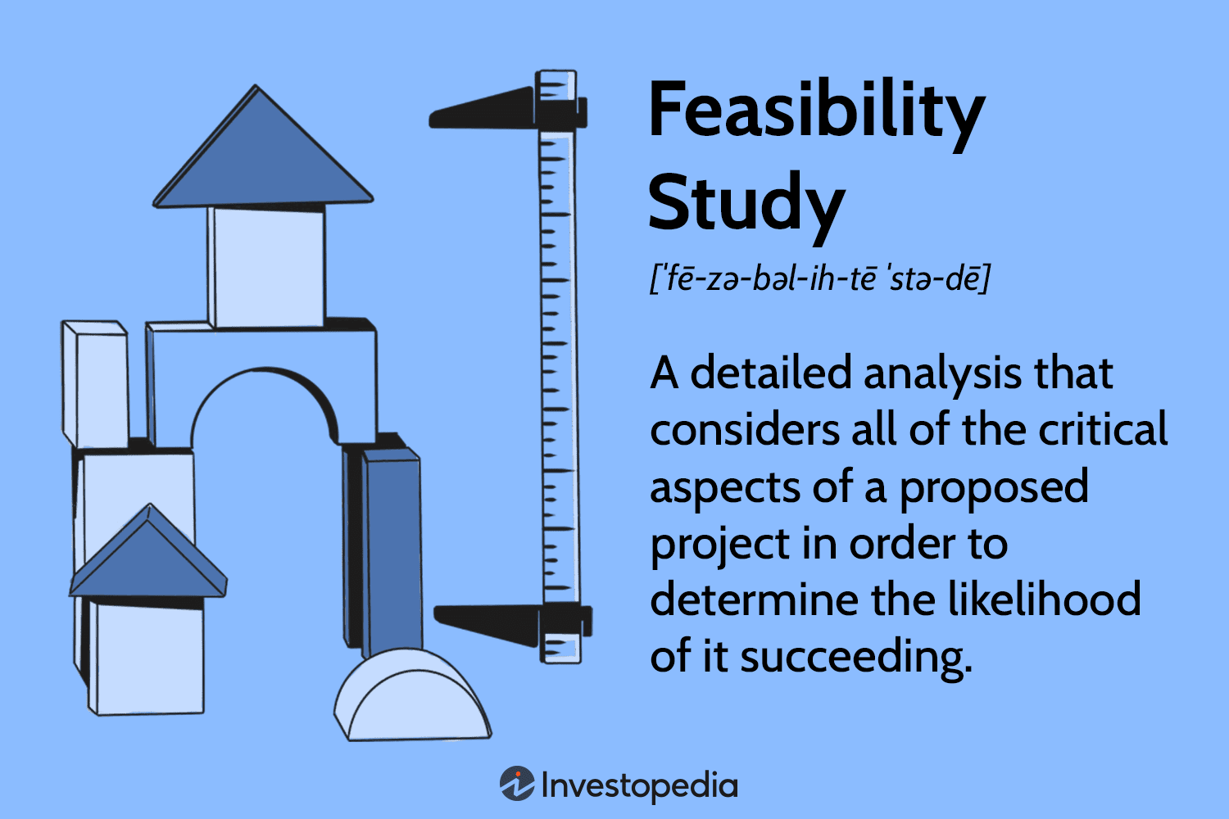
Feasibility Study or Planning
Define the problem and scope of existing system.
Overview the new system and determine its objectives.
Confirm project feasibility and produce the project Schedule.
During this phase, threats, constraints, integration and security of system are also considered.
A feasibility report for the entire project is created at the end of this phase.

Slide 5
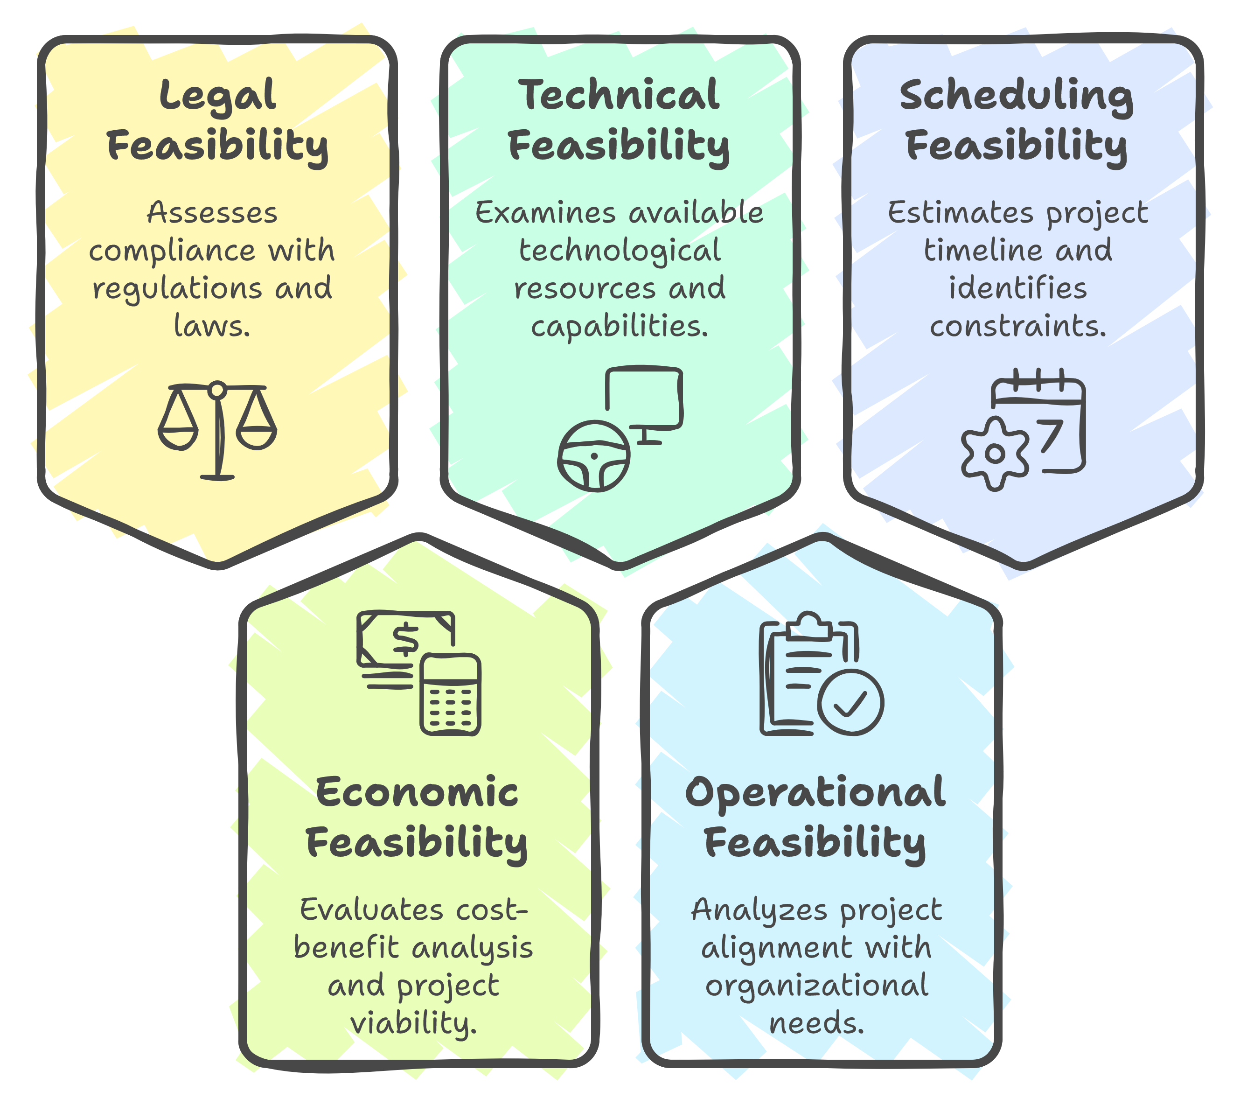
Feasibility Study Types

Slide 6
Legal Feasibility:-
This assessment looks into if any component of the proposed project violates any regulations, such as zoning rules, data protection legislation, or social media laws.
Assume a company wishes to develop a new office building at a specified location. A feasibility study may discover that the desired location for the company is not designated for that sort of business. That organisation has just saved a lot of time and effort by discovering early on that their idea was not feasible.
Economic Feasibility:-
This evaluation typically includes a cost-benefit analysis of the project, which aids firms in determining the project's viability, cost, and benefits before spending financial resources.
It also acts as an objective project review, boosting project credibility by assisting decision-makers in identifying the proposed project's beneficial economic benefits to the organisation.
Technical Feasibility:-
The technological resources accessible to the organisation are the subject of this examination. It aids companies in determining whether technical resources are adequate for the job and whether the technical team is capable of turning concepts into operational systems.
The proposed system's hardware, software, and other technical needs are also evaluated for technical viability. An organisation, for example, would not want to try to install Star Trek's transporters in their facility because it is currently not technically feasible.

Slide 7
Operational Feasibility:-
This evaluation entails conducting research to evaluate whether—and to what extent—the organization's needs can be addressed by completing the project.
Operational feasibility studies also look at how a project plan meets the requirements specified during the system development requirements analysis phase.
Scheduling Feasibility:-
Scheduling a feasibility evaluation is critical to project success; after all, if the project is not completed on time, it will fail.
When scheduling feasibility, a corporation estimates the length of time it will take to complete a project. Following the consideration of all of these elements, the feasibility study can assist in identifying any potential project restrictions, such as:
External restrictions include logistics, the environment, rules and regulations, and so on.
Technological, financial, and resource restrictions are examples of internal project constraints.
Technological, financial, and resource constraints are among the project's internal constraints.

Slide 8
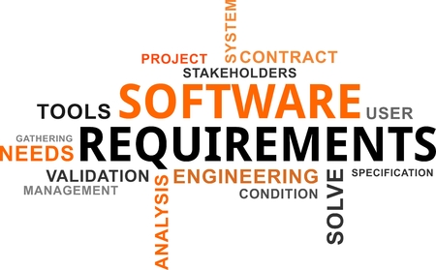
Analysis and Specification
Gather, analyze, and validate the information.
Define the requirements and prototypes for new system.
Evaluate the alternatives and prioritize the requirements.
Examine the information needs of end-user and enhances the system goal.
A Software Requirement Specification (SRS) document, which specifies the software, hardware, functional, and network requirements of the system is prepared at the end of this phase.

Slide 9

System Design
Includes the design of application, network, databases, user interfaces, and system interfaces.
Transform the SRS document into logical structure, which contains detailed and complete set of specifications that can be implemented in a programming language.
Create a contingency, training, maintenance, and operation plan.
Review the proposed design. Ensure that the final design must meet the requirements stated in SRS document.
Finally, prepare a design document which will be used during next phases.

Slide 10

Implementation
Implement the design into source code through coding.
Combine all the modules together into training environment that detects errors and defects.
A test report which contains errors is prepared through test plan that includes test related tasks such as test case generation, testing criteria, and resource allocation for testing.
Integrate the information system into its environment and install the new system.

Slide 11

Maintenance/Support
Include all the activities such as phone support or physical on-site support for users that is required once the system is installing.
Implement the changes that software might undergo over a period of time, or implement any new requirements after the software is deployed at the customer location.
It also includes handling the residual errors and resolve any issues that may exist in the system even after the testing phase.
Maintenance and support may be needed for a longer time for large systems and for a short time for smaller systems.

Slide 12
SDLC: Methodologies
Methodology: a formalized approach to implementing the SDLC
Categories
Process oriented
Data centered
Object-oriented
Structured
Rapid action development
Agile development

Slide 13

Classes of Methodologies
Structured Development
Waterfall Development
Parallel Development
Rapid Application Development
Phased
Prototyping
Agile Development
eXtreme Programming
SCRUM

Slide 14
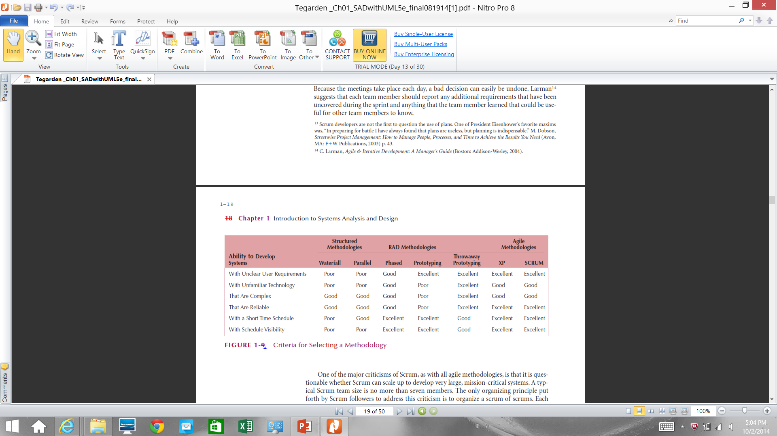
Which Methodology to Use?

Slide 15

Role of
System Analyst
The system analyst is a person who is thoroughly aware of the system and guides the system development project by giving proper directions.
He is an expert having technical and interpersonal skills to carry out development tasks required at each phase.
He pursues to match the objectives of information system with the organization goal.

Slide 16
Main Roles
Defining and understanding the requirement of user through various Fact finding techniques.
Prioritizing the requirements by obtaining user consensus.
Gathering the facts or information and acquires the opinions of users.
Maintains analysis and evaluation to arrive at appropriate system which is more user friendly.
Suggests many flexible alternative solutions, pick the best solution, and quantify cost and benefits.
Draw certain specifications which are easily understood by users and programmer in precise and detailed form.
Implemented the logical design of system which must be modular.
Plan the periodicity for evaluation after it has been used for some time, and modify the system as needed.

Slide 17
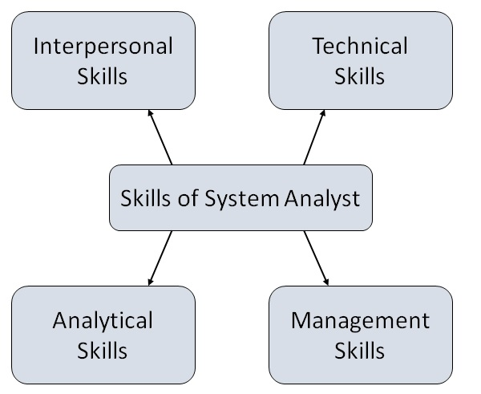
Skills of a System Analyst

Slide 18
Interpersonal Skills
Interface with users and programmer.
Facilitate groups and lead smaller teams
Managing expectations.
Good understanding, communication, selling and teaching abilities.
Motivator having the confidence to solve queries.
Analytical Skills
System study and organizational knowledge
Problem identification, problem analysis, and problem solving
Sound commonsense
Ability to access trade-off
Curiosity to learn about new organization
Management Skills
Understand users jargon and practices.
Resource & project management.
Change & risk management.
Understand the management functions thoroughly.
Technical Skills
Knowledge of computers and software.
Keep abreast of modern development.
Know of system design tools.
Breadth knowledge about new technologies.

Slide 19
Object-Oriented Systems Analysis & Design
Attempts to balance data and process
Utilizes the Unified Modeling Language (UML) and the Unified Process
Characteristics of OOAD:
Use-case Driven
Architecture Centric
Iterative and Incremental

Slide 20
Characteristics of Object-Oriented Systems
Classes & Objects
Object (instance): instantiation of a class
Attributes: information that describes the class
State: describes its values and relationships at a point in time
Methods & Messages
Methods: the behavior of a class
Messages: information sent to an object to trigger a method (procedure call)

Slide 21
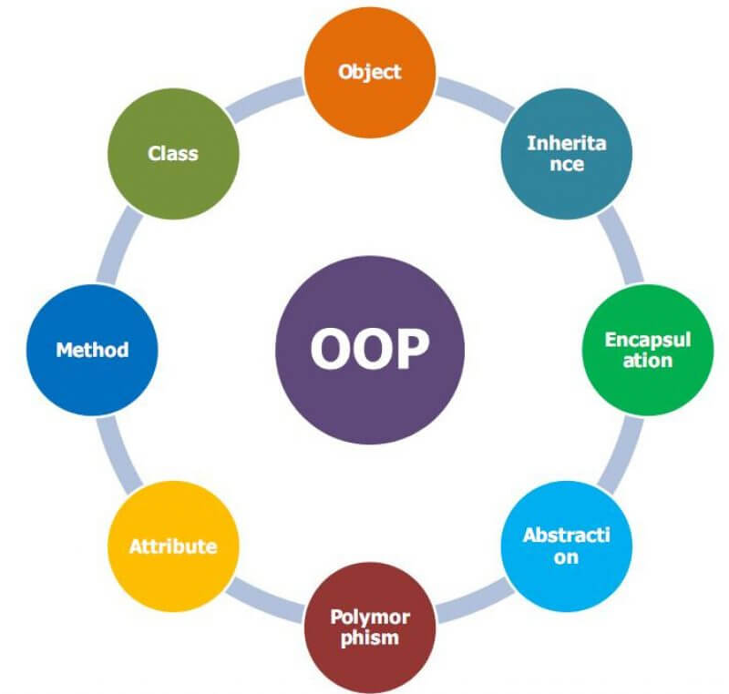
Characteristics of Object-Oriented Systems (cont.)
Encapsulation & information hiding
Encapsulation: combination of process & data
Information hiding: functionality is hidden
Inheritance
General classes are created (superclasses)
Subclasses can inherit data and methods from a superclass
Polymorphism & dynamic binding
Polymorphism: the same message can have different meanings
Dynamic binding: type of object is not determined until run-time
Contrast with static binding

Slide 22
Object-Oriented Systems Analysis & Design
Use-case driven
Use-cases define the behavior of a system
Each use-case focuses on one business process
Architecture centric
Functional (external) view: focuses on the user’s perspective
Static (structural) view: focuses on attributes, methods, classes & relationships
Dynamic (behavioral) view: focuses on messages between classes and resulting behaviors

Slide 23
Object-Oriented Systems Analysis & Design (cont.)
Iterative & incremental
Undergoes continuous testing & refinement
The analyst understands the system better over time
Benefits of OOSAD
Break a complex system into smaller, more manageable modules
Work on modules individually

Slide 24
Unified Modeling Language
Provides a common vocabulary of object-oriented terms and diagramming techniques rich enough to model any systems development project from analysis through implementation
Version 2.5 has 15 diagrams in 2 major groups:
Structure diagrams
Behavior diagrams

Slide 25
UML Structure Diagrams
Represent the data and static relationships in an information system
Class
Object
Package
Deployment
Component
Composite structure

Slide 26
UML Behavior Diagrams
Depict the dynamic relationships among the instances or objects that represent the business information system
Activity
Sequence
Communication
Interaction overview
Timing
Behavior state machine
Protocol state machine,
Use-case diagrams

Slide 27
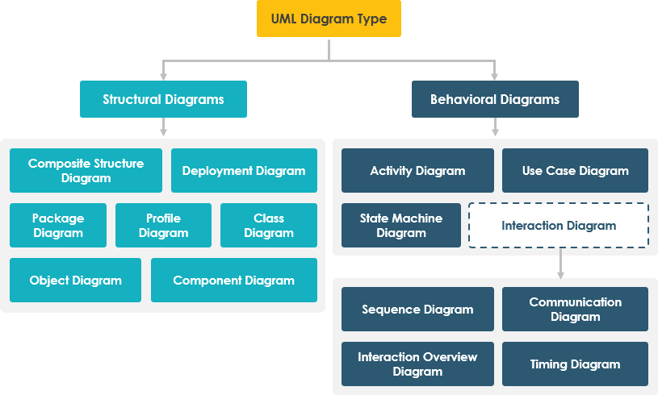

Slide 28
Summary
All systems development projects follow essentially the same process, called the system development life cycle (SDLC)
System development methodologies are formalized approaches to implementing SDLCs
The systems analyst needs a variety of skills and plays a number of different roles
Object-oriented systems differ from traditional systems

Slide 29
Summary
Object-Oriented Systems Analysis and Design (OOSAD) uses a use-case-driven, architecture-centric, iterative, and incremental information systems development approach
The Unified Process is a two-dimensional systems development process described with a set of phases and workflows
The Unified Modeling Language, or UML, is a standard set of diagramming techniques

Slide 30

Q/A

